Slide 1
APCD user workgroup
Don Kirkwood (Manager of Data Release and Procurement)
Sylvia Hobbs (Manager of User Support)
Scott Curley (Manager Privacy & Compliance)
September 22, 2020
CENTER FOR HEALTH INFORMATION AND ANALYSIS

Slide 2
Agenda
Announcements:
  APCD Release 8.0 Updates
  FY19 Case Mix Release Projections
  Data Release and Application Update
Website Updates
Application Reminders
User Support Questions
  Date data in the MA APCD
  Payment Arrangement Type
  Senior Care Option Products
  Coding for Pregnancy Supervision
Q&A

Slide 3
MA APCD Release 8.0
  Available NOW
  Applicants with approved projects that require updated APCD data (Release 8.0) should submit to CHIA a completed Exhibit B (Certificate of Continued Need and Compliance) of the Data Use Agreement. After submitting a completed Exhibit B you will receive an invoice (if applicable) for the requested data. Upon payment of the invoice the order for the data will be placed.
  Release 8.0 includes data on services from January 2014 – December 2018 with six months of claim runout (includes paid claims through 6/30/19).
  Will be linkable to Release 7.0 via crosswalk
  Additional information on highlights and enhancements will be presented in future APCD User Workgroups.

Slide 4

Case Mix FY19 Release
*CURRENT* RELEASE TIMEFRAMES FOR EACH FILE:
  Inpatient (HIDD)
  Available for request
  Emergency Department (ED)
  Available for request
  Outpatient Observation (OOD)
  Available for request
  Applicants with approved projects that require newly available year(s) of Case Mix Data (e.g., FY 19) should submit to CHIA a completed Exhibit B (Certificate of Continued Need and Compliance) of the Data Use Agreement. After submitting a completed Exhibit B you will receive an invoice (if applicable) for the requested data. Upon payment of the invoice the order for the data will be placed.

Slide 5
Data Release and Application Updates
Due to Governor Baker’s emergency actions to limit the spread of COVID-19 CHIA’s workforce will be remote, for now. This arrangement will limit CHIA’s ability to produce and deliver data extracts. At this time, CHIA is releasing data and providing extracts to requestors.
During this time, CHIA will continue to accept and review data applications for both Case Mix and All-Payer Claims Database (MA APCD) datasets. Review committees, DRC and DPC, will continue their meetings remotely as necessary.
Due to CHIA’s physical office being closed, applications will be accepted without a fee. After receipt of the application, CHIA will issue an invoice which will allow applicants to remit payment online.
If you are a Data User that has a CHIA hard drive in your possession, please keep the hard drive at this time while CHIA’s physical office is closed.

Slide 6
Website Release Updates
  Updates on the production of APCD and Case Mix databases and status of data requests are now posted to CHIA’s website!
    Aim #1 is to provide weekly or bi-weekly status update on CHIA data products as they are in development.
    Aim #2 is to provide applicants with information about expected fulfillment status for individual data requests.
    Request IDs will be communicated to Data Requestors via email.
  Please visit http://www.chiamass.gov/status-of-data-requests/ to see the current status of releases.

Slide 7
Application reminders

Slide 8
Fee Waiver Request Reminders
  If you’re submitting a request for a fee waiver, remember to include the fee remittance form in your application package on IRBNet.
  Remember to submit supporting documentation (if required).
  If you’re requesting a financial hardship waiver, remember to submit information detailing your project’s financial situation (examples: project budget, grant funding, organizational / departmental funding). Also request to pay a specific price that you reasonably believe you’re able to afford to contribute.
  CHIA generally does not offer full financial hardship fee waivers. We expect all applicants to have made an attempt to find funding to cover the full cost of the data fees.
  Fee waiver requests can take some time to process – especially financial hardship requests.

Slide 9
USER questions

Slide 10

Question: The medical claims file contains a field called, “Payment Arrangement Type” (MC113). I am trying to understand the difference between these payment models. Should I expect a difference in volume of claims using a specific model and differences in length of time between dates of service and payment based on payment model?
PAYMENT MODELS
Answer: Below are the lookup values for each of the Payment Models and a discussion of their definition and the proportion of the total paid amount they represent in MA APCD Release 7 highest version medical claims.
Value | Description | Definition
01 | Capitation | Capitation is a fixed amount paid to the health care provider per enrollee per unit of time (for example, per month) for health care delivery. In MA APCD Release 7, capitation is used on less than 1% of the total medical claims paid amount on the highest version of claims.
02 | Fee for Service | Fee-for-service pays the provider separately for each particular service or test rendered. This is the most frequently used payment type in the medical claims representing 60% of the total medical claims paid amount.
03 | Percent of Charges | Percent-of-charges method is used by commercial payers to reimburse hospital and other facility claims based on a contracted percentage of total charges in a claim. For example, if the contracted percentage is 80% of charges and total charges in a hospital claims are $10,000, the expected reimbursement is 80% of $10,000, which equals $8,000. This method represents 4% of medical claims paid amount.
04 | DRG | Limited to inpatient hospital services paid based on a predetermined rate per discharge, using the DRG patient classification system and represents 22% of total medical claims paid amount.
05 | Pay for Performance | Pay-for-performance provides financial incentives for providers to improve patient outcomes based on select performance measures, for example, reducing readmissions. This method represents less than 1 percent of total medical claims paid amount.
06 | Global Payment | Global payment is a fixed fee arrangement where the provider agrees to allow a fixed fee for all treatment relating to specific areas of care. This method represents less than 1% of the total medical claims paid amount
07 | Other | Other represents 4% of total medical claims paid.
08 | Bundled Payment | Bundled payments reimburse multiple providers through a single, negotiated payment for all episodes of care related to treatments. In MA APCD Release 7, no medical claims designated bundled payment as the payment method.
09 | Payment Amount per Episode (PAPE) (valid for MassHealth orgid ONLY) | Payment Amount per Episode is limited to MassHealth claims. In MA APCD Release 7, no medical claims designated PAPE as the payment method.
10 | Enhanced Ambulatory Patient Grouping (EAPG) (valid for MassHealth orgid ONLY) | Limited MassHealth claims for outpatient services paid based on predetermined rate using MassHealth's outpatient grouping classification system. In MA APCD Release 7, it represents less than 1% of total medical claims paid amount and 2% of MassHealth total medical claims paid.

Slide 11

Question (continued): Should I expect a difference in length of time between dates of service and claims processing dates and payment dates based on payment model?
PAYMENT DATES
Answer: Yes, using MA APCD Release 7 , highest version medical claims incurred in
calendar year 2015 to compare the median and average length of difference in days
between the date of service to and claims processed date, DRG payment type, followed by pay for performance, and capitation are processed in the shortest amount of time. Capitation claims, followed by pay for performance, and DRG claims are paid in the shortest amount of time. Table 1 below compares average date difference and due to outliers, includes a comparison of median date difference.
Table 1. Comparison of Median and Average Date Difference from Service to Payment by Payment Model
Code Value | DESCRIPTION | Median Difference in Days Between Date Claim Processed and Date of Service To | Average Difference in Days Between Date Claim Processed and Date of Service To |  | Median Difference in Days Between Date Claim Paid and Date of Service To | Average Difference in Days Between Date Claim Paid and Date of Service To
01 | Capitation | 15 | 24 |  | 17 | 26
02 | Fee for Service | 20 | 55 |  | 34 | 67
03 | Percent of Charges | 21 | 40 |  | 26 | 44
04 | DRG | 9 | 23 |  | 23 | 38
05 | Pay for Performance | 14 | 24 |  | 18 | 26
06 | Global Payment | 137 | 188 |  | 137 | 189
07 | Other | 21 | 38 |  | 22 | 40
09 | PAPE (MassHealth) | 22 | 50 |  | 43 | 70

Slide 12
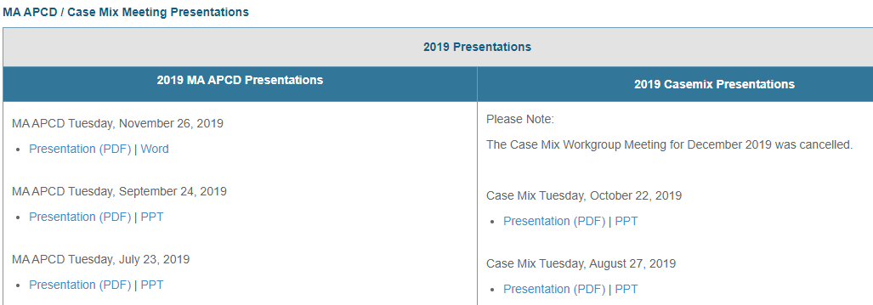
Where can I find past User Workgroup Presentations?
http://www.chiamass.gov/ma-apcd-and-case-mix-user-workgroup-information/

Slide 13
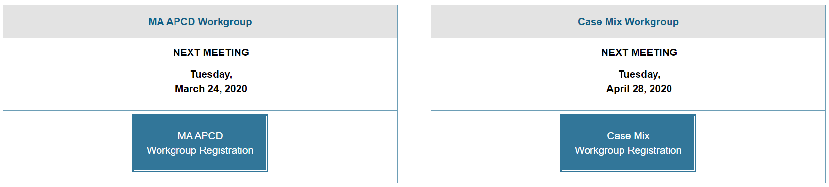
When is the next User Group meeting?
The next User Group will meet Tuesday, October 27.
http://www.chiamass.gov/ma-apcd-and-case-mix-user-workgroup-information/

Slide 14
Questions?
Questions related to MA APCD:
apcd.data@state.ma.us
Questions related to Case Mix:
casemix.data@state.ma.us
REMINDER: Please include your IRBNet ID#, if you currently have a project using CHIA data.

Slide 15
Call for Topics and Presenters
If there is a TOPIC that you would like to see discussed at an MA APCD or Case Mix workgroup in 2020, contact Amy Wyeth [amy.wyeth@state.ma.us]
If you are interested in PRESENTING at a MA APCD or Case Mix workgroup in 2020, contact Amy Wyeth [amy.wyeth@state.ma.us]
You can present remotely, or in-person at CHIA
We may be reaching out to some data users with invitations to present, and hope you will consider this!

