Slide 1
Massachusetts All-Payer Claims Database: Technical Assistance Group (TAG)
June 14, 2022

Slide 2
Agenda
MA APCD
Enrollment Trends
DOI Reporting
Questions

Slide 3
MA APCD Intake
All APCD submissions through April 2022 were due by May 31^{st.} This includes any re-submissions.
Please work with your liaison in submitting any overdue files and alert them if you expect any further delays.
Data will be used towards Q2 2022 DOI membership and other quarterly reporting.
CHIA is revisiting Medical Claim versioning methods with select payers. We’ll reach out when we have examples to share with each company.

Slide 4
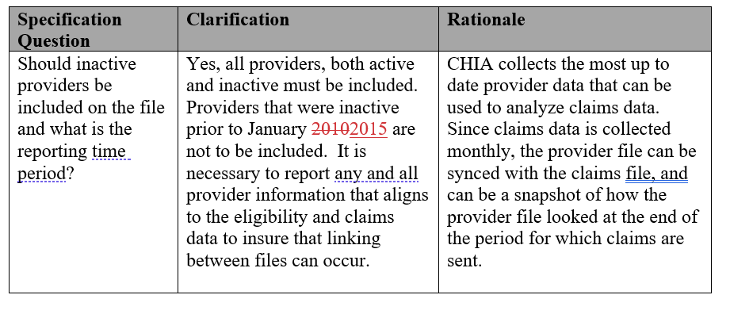
MA APCD – 2022 Provider Submission Guide Update (Page 9)

Slide 5
MA APCD – 2022 Pharmacy Claims Submission Guide Update (Page 21)
10 digits max. For example, 111954.032, -25.0492 or .019298285, etc. depending on what is in your data for this field. Decimal point is included in the 10 digits max count.

Slide 6
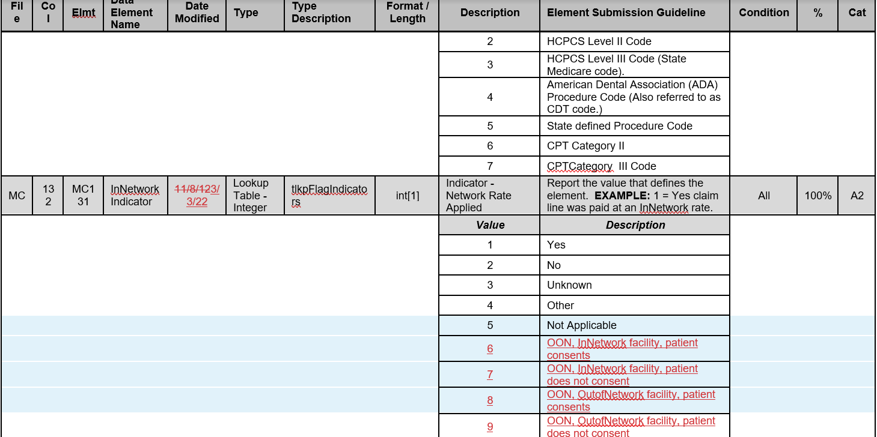
MA APCD – 2022 Medical Claims Submission Guide Update (Page 48)

Slide 7
MA APCD Intake Version 2022
Final versions of the updated submission guides are posted to CHIA’s website. No change from draft versions.
APCD submitters may send test files in July 2022. Please work with your liaison if you want to do this.
Production files with submission guide changes are due by 8/31 for July 2022 data.
There is no change to the version field in the header record – it remains ‘2019’.

Slide 8
Enrollment Trends Update
The next Enrollment Trends reporting cycle will be based on data through March 2022 and is scheduled to be published in August 2022.
CHIA shared MA APCD-sourced enrollment counts for payer review this week. These enrollment counts are based on payers’ March 2022 ME submissions and do not reflect any supplemental data.
Please contact us with any comments or concerns about this data before June 30, 2022. Feedback received after this date may not be incorporated into the upcoming report.
Thank you to the payers that submitted Supplemental Data as requested last month.
For questions on Enrollment Trends: Contact your CHIA liaison.

Slide 9
Enrollment Trends Timeline
Apr 2022 | May 2022 | Jun 2022 | Jul 2022 | Aug 2022
Payers submit March 2022 MA APCD files
 | Supplemental enrollment reports due (select payers)
 |  | MA APCD enrollment counts sent to payers for review
 |  |  | Reporting

Slide 10
DOI Reporting
Q1 2022 HMO Membership reports were sent 5/23. Signoff is due by 7/8.
CY2021 Membership reports were sent on 3/16. Signoff was due by 4/29.
Claims/Utilization:
Reports using data through September 2021 were sent on 3/7. Signoff was due by 5/7.
Reports using data through March 2022 are in process.
We continue to meet with select payers to reconcile differences in certain report categories.

Slide 11
Next Meetings
July 12, 2022 @ 2:00 pm
August 9, 2022 @ 2:00 pm

Slide 12
Questions?

