Slide 1
Massachusetts All-Payer Claims Database: Technical Assistance Group (TAG)
March 8, 2022

Slide 2
Agenda
MA APCD
Enrollment Trends
DOI Reporting
Questions

Slide 3
MA APCD Intake
All APCD submissions through January 2022 were due by February 28^{th.} This includes any re-submissions.
Please work with your liaison in submitting any overdue files and alert them if you expect any delays.
CHIA is revisiting Medical Claim versioning methods with select payers. We’ll reach out when we have examples to share with each company.

Slide 4
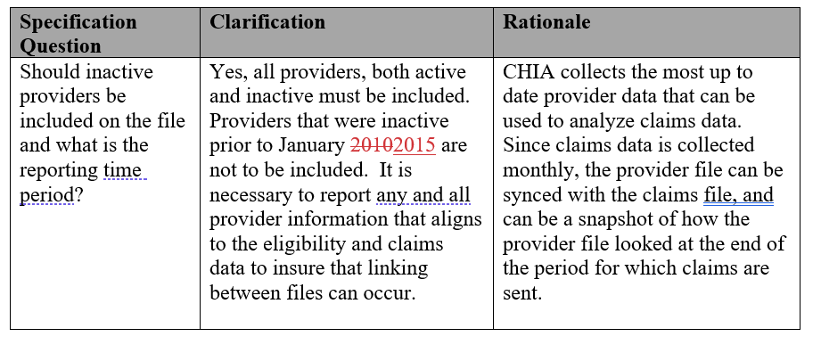
MA APCD – 2022 Provider Submission Guide Update (Page 9)

Slide 5
MA APCD – 2022 Pharmacy Claims Submission Guide Update (Page 21)

Slide 6
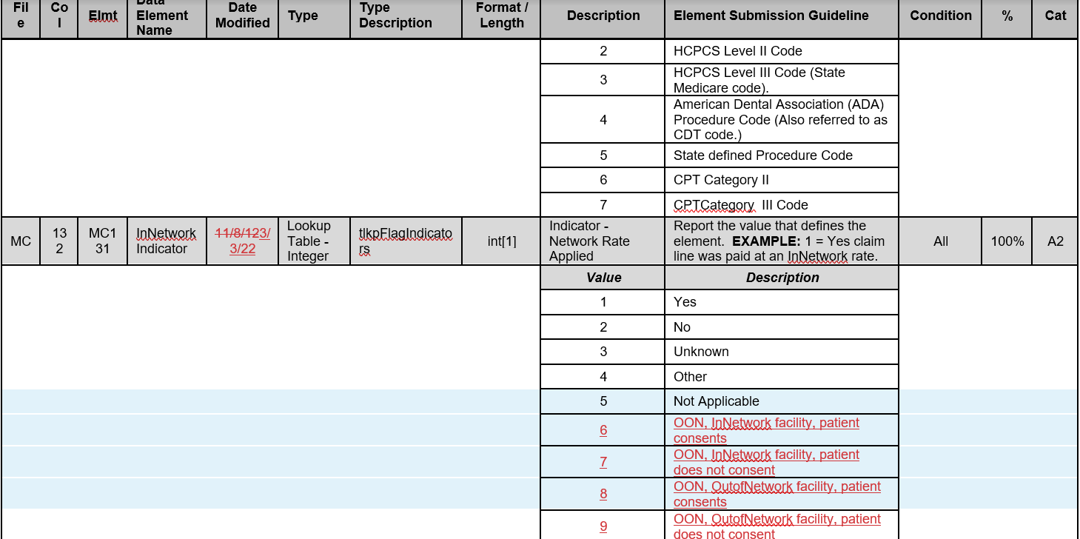
MA APCD – 2022 Medical Claims Submission Guide Update (Page 48)

Slide 7
MA APCD Intake Version 2022
MA APCD Intake Process | 2022 Intake Timeline
Proposals Shared/Discussed with Carriers | December 2021/January 2022
Draft Submission Guides published | January/February 2022
Guide Changes Reviewed at Technical Advisory Group | January /February 2022
Carrier Comment Period | February 2022
Administrative Bulletin and Guides Adopted | February 2022
Development/Testing | February/July 2022
Carrier Testing – new guides and transmission process changes (if any) | July 2022
MA APCD Intake Version 2022 Production (July 2022 data) | August 2022

Slide 8
Enrollment Trends Timeline
Oct 2021 | Nov 2021 | Dec 2021 | Jan 2022 | Feb 2022 | Mar 2022
Payers submit Sept 2021 MA APCD files
 | Supplemental enrollment reports due (select payers)
 |  | MA APCD enrollment counts sent to payers for review
 |  |  | Reporting

Slide 9
DOI Reporting
Q4 2021 HMO Membership reports were sent last week. Signoff is due by 4/18.
CY2021 Membership reports will be distributed later this month.
Claims/Utilization:
Reports using data through September 2021 were sent yesterday. Signoff is due by 5/7.
We continue to meet with select payers to reconcile differences in certain report categories.

Slide 10
Next Meetings
April 12, 2022 @ 2:00 pm
May 10, 2022 @ 2:00 pm

Slide 11
Questions?

