Slide 1
Massachusetts All-Payer Claims Database: Technical Assistance Group (TAG)
March 20, 2018

Slide 2
Agenda
APCD Intake Notes
Housekeeping Items
TME, APM, RP Reporting
Annual Premiums Data Request
Questions

Slide 3
APCD Intake - Compliance
By end of March 2018 – production files through February 2018 are due at CHIA
Any outstanding files for 2017 need to be submitted ASAP as we are preparing for year end reports.

Slide 4
APCD Intake - Changes for ACOs
Product Line of Business (PR004) / Insurance Type Code/Product (ME003, MC003, PC003, DC003) will have ‘30’ for ACO-MassHealth and ‘31’ for ACO-Commercial added as lookup table values.
ACO-MassHealth – any ACO business that covers a MassHealth member
ACO-Commercial – placeholder for now
Product ID Number for each ACO Partnership Plan – populated in PR001, ME040, MC079, PC056, DC042. Carriers will provide a crosswalk for the Product ID Number to the ACO Plan Name and CHIA will maintain the lookup table.

Slide 5
Housekeeping Items
DOI Reporting:
Q4 2017 HMO Membership report – responses due by 4/19
CY 2017 Annual Membership report – under internal review. Liaisons should be sending this week to select carriers.

Slide 6
Payer Data Reporting: TME, APM, RP
Deadlines
Deadline | Data File Due
Tuesday, May 1, 2018 | CY 2016 Final TME
 | CY 2017 Preliminary TME
Friday, June 1, 2018 | CY 2016 Final APM
 | CY 2017 Preliminary APM
 | CY 2016 Prescription Drug Rebates
 | CY 2017 Prescription Drug Rebates
Friday, June 29, 2018 | CY 2017 Hospital RP
Friday, July 13, 2018 | CY 2017 Other Provider RP
 | CY 2016 Physician Group RP

Slide 7
Annual Premiums
Data Request

Slide 8
2018 Annual Premiums Data Request
The finalized Data Submission Manual and Reporting Workbook were emailed to payer representatives last week.
Materials are also available for download from CHIA’s website at http://www.chiamass.gov/information-for-data-submitters-premiums-data/.

Slide 9
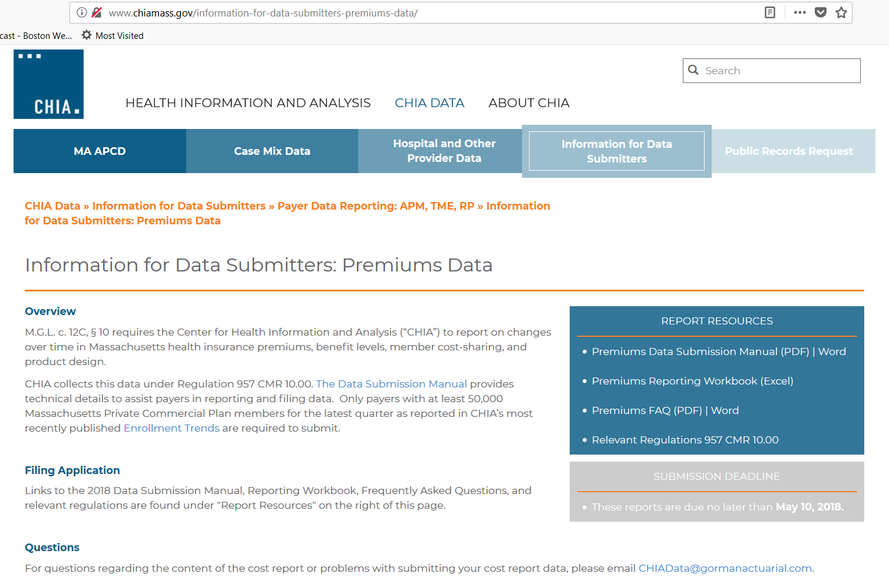

Slide 10
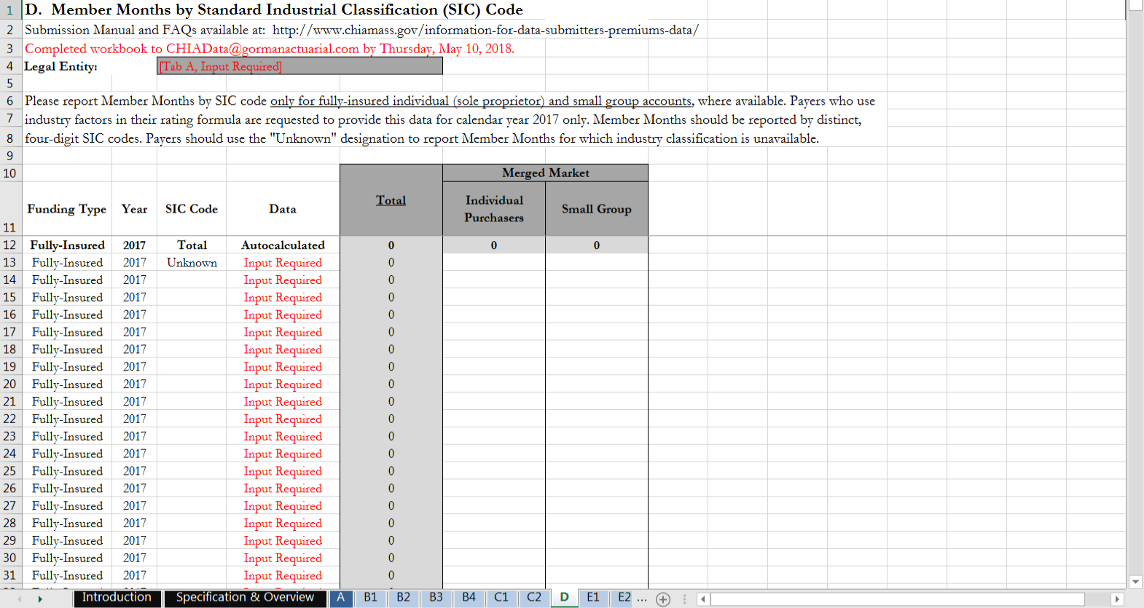
Updated Tab D: Member Months by SIC Code
A line was added to row 13 to document member months without known industry codes.

Slide 11
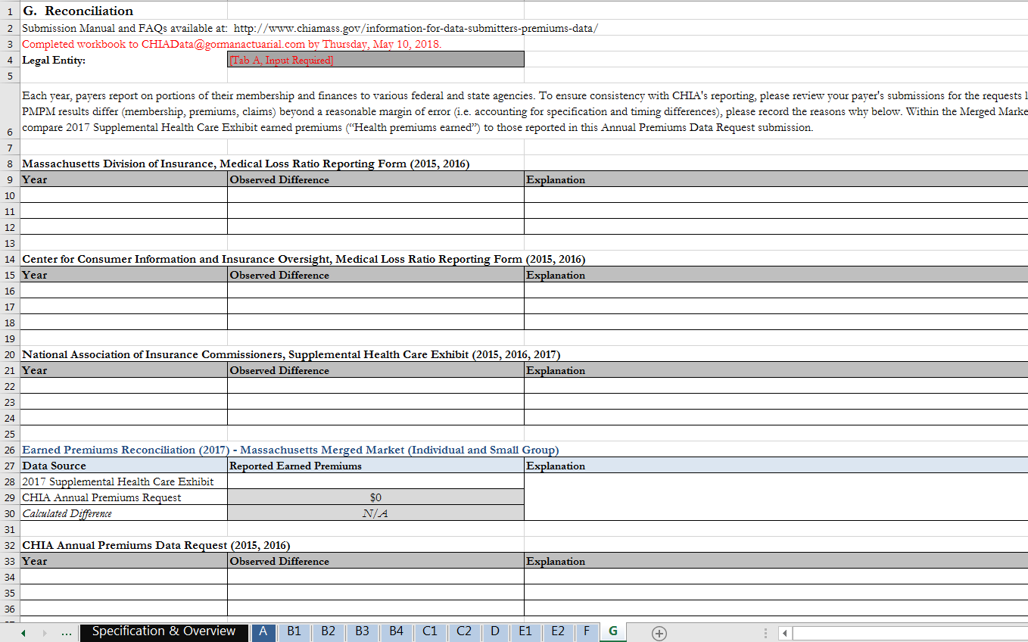
Updated Tab G: Reconciliation
Reconcile against Massachusetts MLR form rather than ACFS
Reconcile 2017 Merged Market aggregate premiums between SHCE and this data submission

Slide 12
2018 Annual Premiums Request Deadlines
Completed workbooks (containing data for 2015-2017 plan years) should be submitted to CHIAData@gormanactuarial.com by May 10, 2018.
CHIA will follow up with payers in July to collect Risk Adjustment and MLR Rebate amounts for 2017.

Slide 13
2018 Annual Premiums Request Timeline
Feb. 2018 | Mar. 2018 | Apr. 2018 | May 2018 | Jun. 2018 | Jul. 2018 | Aug. 2018 | Sept. 2018
Payers review draft materials
 | Final 2018 Premiums Request released
 |  |  | Submissions due
 |  |  |  | Data analysis and reporting
 |  |  |  |  | 2017 Risk Adjustment data due
 |  |  |  |  |  |  | CHIA’s Annual Report

Slide 14
Contact Information – New Actuarial Firm
For Annual Premiums technical questions and data submission:
Contact CHIAData@gormanactuarial.com

Slide 15
Next Meetings
April 10, 2018 @ 2:00 pm
May 8, 2018 @ 2:00 pm

Slide 16
Questions?

