Slide 1
Massachusetts All-Payer Claims Database: Technical Assistance Group (TAG)
June 14, 2016

Slide 2
Agenda
APCD Version 5.0 Intake
TME/APM/RP
Annual Premiums Data Request, Enrollment Trends and Medical Expenditure Trends Updates
Wrap Up

Slide 3
Intake Version 5.0
MA APCD Intake Process | Timeline
Data Partners Propose Version 5 Updates | November 2015
Proposals Shared/Discussed with Carriers | December 2015
Draft Submission Guides published | January 2016
Guides Reviewed at Technical Advisory Group | January 2016
Carrier Comment Period | January 2016
Administrative Bulletin and Guides Adopted | February 2016
Development/Testing | March/June 2016
Carrier Testing | July 2016
MA APCD Intake Version 5 Production | August 2016

Slide 4
APCD Version 5.0 Intake
APCD V5 carrier testing begins in July
Production data begins in August for July data
Any resubmissions from Oct 2013 forward will need to be in V5 format beginning in August
Variance workbooks will be sent to carriers this month

Slide 5
Payer Data Filing Schedule
File Type | File | Deadline
TME | CY 2014 Final TME - ZIP code records | May 2, 2016
 | CY 2015 Preliminary TME (+ IBNR factors) - ZIP code records | May 2, 2016
 | Physician Group TME for both years | May 16, 2016
APM | CY 2015 Preliminary APM (+ IBNR factors) | June 1, 2016
 | CY 2014 Final APM | June 15, 2016
 | CY 2015 Supplemental APM (for payers reported global payments only) | June 15, 2016
RP | CY 2015 Hospital Relative Price | July 1, 2016
 | CY 2014 Physician Group Relative Price | July 1, 2016
 | CY 2015 Other Provider Relative Price | July 1, 2016
For more information, please see Administrative Bulletin 16-04; 957 CMR 2.00: Payer Data Reporting available at: http://www.chiamass.gov/assets/docs/g/chia-ab/16-04.pdf.

Slide 6
CHIA Reporting Updates:
Annual Premiums Data Request, Enrollment Trends, and Medical Expenditure Trends
Ashley Storms | Senior Health System Policy Analyst
Kevin Meives | Senior Health System Policy Analyst
June 14th, 2016

Slide 7
Annual Premiums Data Request

Slide 8
2016 Annual Premiums Data Request Update
Thank you for submitting the 2016 Request
Follow-up questions and resubmission requests were sent Tuesday, June 7th
We will also follow-up in July for 2015 “3R” amounts

Slide 9
Timeline
June 2016 | July 2016 |  | August 2016
Anomaly Identification & Resolution
 |  | Follow-up for 2015 “3R” and MLR amounts
 |  |  |  | CHIA’s 2016 Annual Report finalized

Slide 10
Enrollment Trends

Slide 11
APCD Data Verification
July 2016 Enrollment Trends will report membership from December 31, 2013 through March 31, 2016.
Data will be sourced from September 2015 (already verified), December 2015, and March 2016 Member Eligibility files.
As always, payers will have the opportunity to review APCD-based enrollment counts prior to publication.

Slide 12
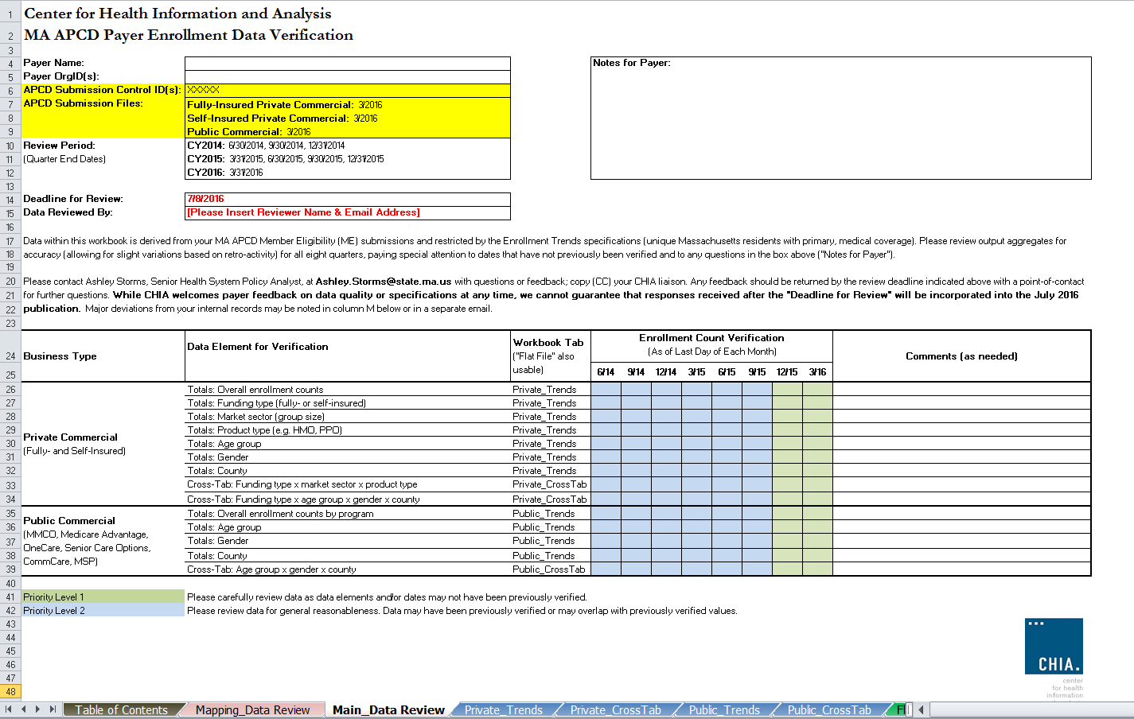
APCD Data Verification: Main Report

Slide 13
APCD Data Verification: Mapping Appendix
For the first time, CHIA will release a membership Mapping Appendix to complement the main Enrollment Trends report.
Membership Mapping Appendix will illustrate geographic distribution of payers’ private commercial membership by county in December 2015 and change since December 2013.
MA APCD population only, sourced from September 2015 and December 2015 Member Eligibility submissions

Slide 14
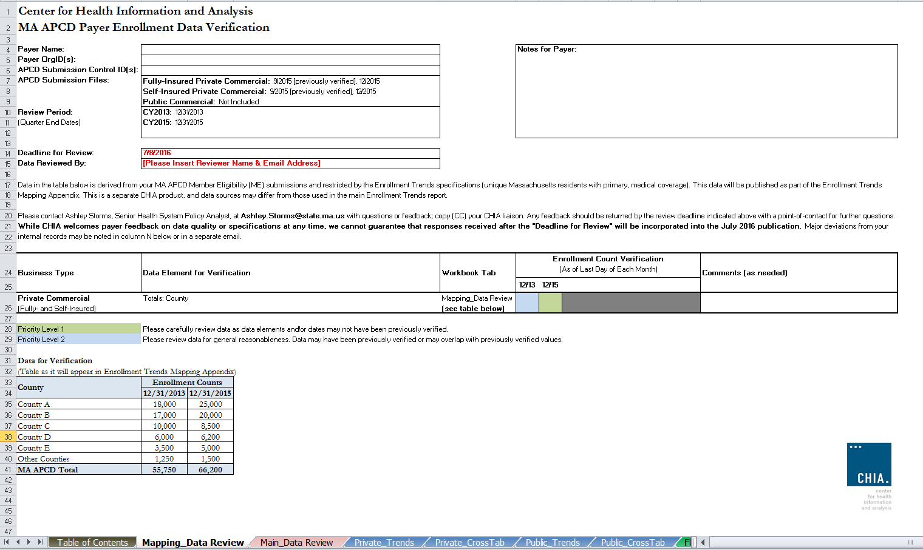
APCD Data Verification: Mapping Appendix

Slide 15
APCD Data Verification: Expectations
Please review data breakouts to ensure that counts and trends appear reasonable.
We are not requesting a detailed reconciliation of each data point.
Payer feedback on data quality/specifications is always welcome; however, responses received after Friday, July 8th may not be fully incorporated into the July 2016 report.

Slide 16
Timeline
Mar. 2016 | Apr. 2016 | May 2016 | June 2016 | July 2016
Work with individual payers to fix remaining reporting issues; validate new MA APCD fields for ongoing enrollment reporting
 | March 2016 MA APCD file submissions
 |  | Supplemental reporting due (requested payers)
 |  |  | Payer APCD data verification
 |  |  |  | Reporting

Slide 17
Medical Expenditure
Trends

Slide 18
MET Data Verification
We will soon ask you to verify Payer- and Patient-Paid Medical Expenditures for calendar year 2014
The verification workbook will follow the Enrollment Trends format
It will ask you to verify data from either your APCD submissions or your Financial Control Total submissions

Slide 19
Contact Information
For questions about Annual Premiums or Medical Expenditure Trends:
Contact your CHIA liaison and Kevin McAvey at kevin.mcavey@state.ma.us
For questions about Enrollment Trends:
Contact your CHIA liaison and Ashley Storms at ashley.storms@state.ma.us

Slide 20
Next Meetings
July 12, 2016 @ 2:00 pm
August 9, 2016 @ 2:00 pm

Slide 21
Questions?

