Slide 1
Massachusetts All-Payer Claims Database: Technical Assistance Group (TAG)
December 8, 2015

Slide 2
Agenda
Housekeeping
Intake Version 5.0
Enrollment and Medical Expenditure Trends Updates
Wrap Up

Slide 3
Housekeeping
Pharmacy Claims Versioning
Division of Insurance (DOI) Meetings

Slide 4
Intake Version 5.0
MA APCD Intake Process | Timeline
Data Partners Propose Version 5 Updates | November 2015
Proposals Shared/Discussed with Carriers | December 2015
Draft Submission Guides published | January 2016
Guides Reviewed at Technical Advisory Group | January 2016
Carrier Comment Period | January 2016
Administrative Bulletin and Guides Adopted | February 2016
Development/Testing | March/June 2016
Carrier Testing | July 2016
MA APCD Intake Version 5 Production | August 2016

Slide 5
Intake Version 5.0
Minimal Changes
No New Data Elements
Limited to Provider and Eligibility
Updated Edits
Category/Threshold Updates
Language Clarifications

Slide 6
Intake Version 5: Provider
Providers inactive before January 2010 should not be included
Update edits
PV011 – Suffix
Repurpose to capture clinical suffix (i.e. MD, DO, NP, etc)
PV032 – Registered Provider Organization (RPO)
Move from Category Z to Category B

Slide 7
Intake Version 5: Provider
PV034 – Provider ID Code
Update edits against NPPES
PV039 – National Provider ID
Update edits against NPPES
PV056 – Provider Affiliation
Update to Category A - Lower Threshold

Slide 8
Intake Version 5.0: Eligibility
ME031 – Special Coverage
Add code for Connector Care
ME046 – Member PCP ID
Update threshold

Slide 9
Future Updates: Workgroups
Premiums Workgroup
Provider Workgroup
Coverage Flag Workgroup
Plan/Network/Cost Share/Product Workgroup

Slide 10
CHIA Public Reporting Updates:
Enrollment and Medical Expenditure Trends
Ashley Storms | Senior Health System Policy Analyst
Kevin Meives | Senior Health System Policy Analyst
December 8, 2015

Slide 11
Enrollment Trends

Slide 12
Enrollment Trends Timeline
Sept. 2015 | Oct. 2015 | Nov. 2015 | Dec. 2015 | Jan. 2016
Follow-up on remaining data issues
 | Supplemental enrollment reporting (identified payers)
 | Sept. 2015 file submission
 |  | Data analysis
 |  | Payer data verification
 |  |  |  | Reporting
Payer data verification deadline: December 29, 2015

Slide 13
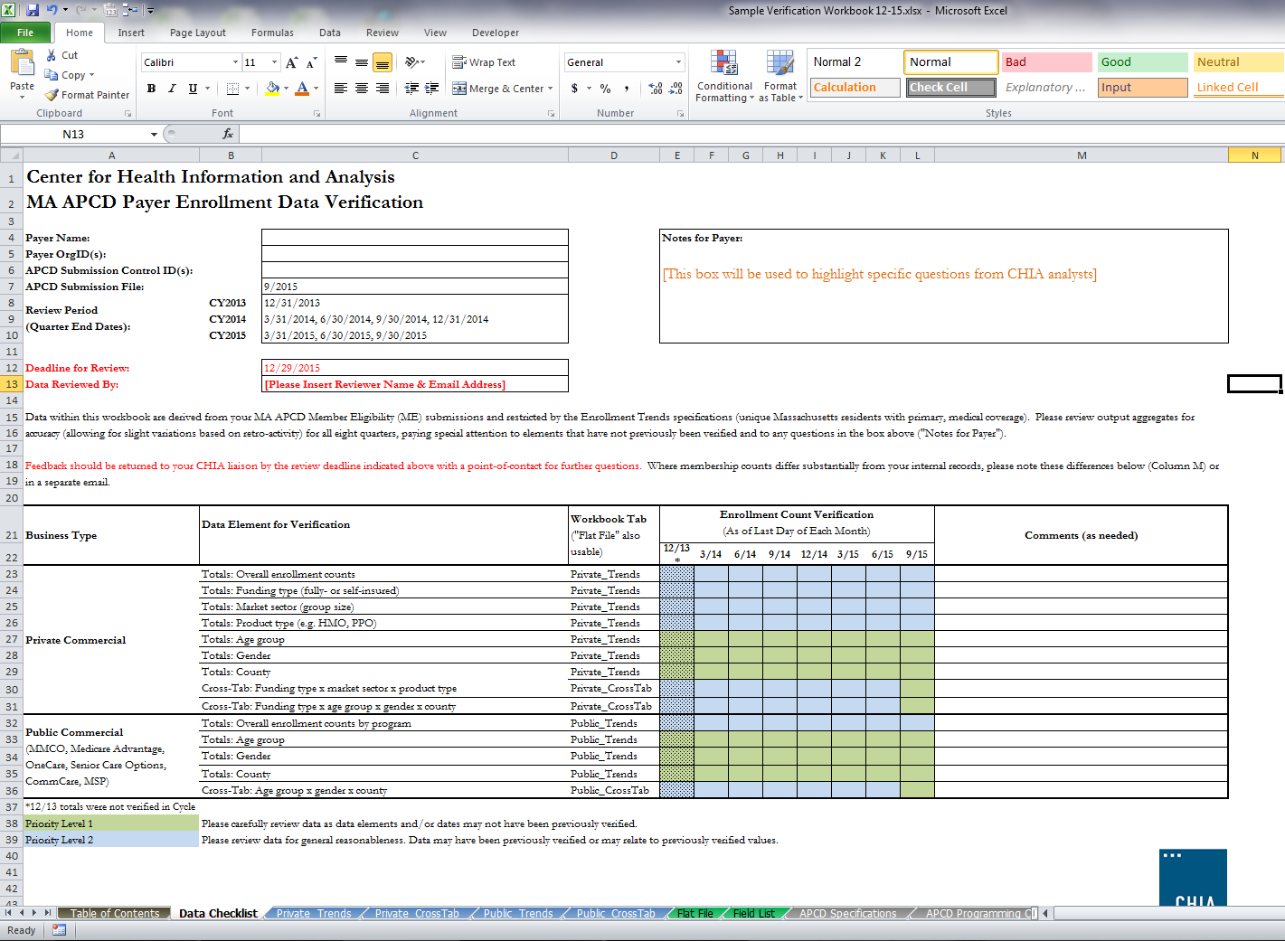
Enrollment Trends Verification Workbook

Slide 14
Enrollment Trends Verification Workbook

Slide 15
Enrollment Trends Verification Workbook

Slide 16
Enrollment Trends Verification Workbook
Feedback should be returned to your CHIA liaison by December 29th
Payers may save “Data Checklist” tab in a new workbook and return to liaison with any comments
Include name and email address for main point of contact

Slide 17
Medical Expenditure
Trends

Slide 18
Medical Expenditure Trends
Enrollment Trends has produced accurate, reliable membership data for each payer using the payers’ Member Eligibility (ME) files
Next step is to assign and verify – for accuracy and completeness – those members’ medical claims, as submitted in payers’ Medical Claims (MC) files
Goal
To produce reliable, payer-verified per member per month (PMPM) measures of the cost of health care services for Massachusetts residents by enrollment subpopulations. For example:
Total monthly expenditures by market sector
Payer-paid PMPMs for fully-insured HMO enrollees:

Slide 19
Methods
Payers’ Medical Claims (MC) data merged to Member Eligibility (ME) data on Carrier Specific Unique Member ID (ME107) for:
The Enrollment Trends population;
Claims with dates of services in State Fiscal Year 2014 (July 2013 – June 2014).
Run out into CY2015
Analysis restricted to “final versioned” medical claims, using CHIA logic developed in partnership with payers
Like enrollment, claims data will be able to be aggregated and analyzed by Coverage Type (ME029), Insurance Type Code Product (ME003), and Market Category Code (ME030) for commercial, MassHealth MCO, and Medicare Advantage populations.

Slide 20
Methods
Working to understand how each payer populates these APCD fields
Individual financial fields are building blocks to total medical costs PMPM, broken out by patient- vs. payer-paid
Compared against quality control totals (e.g. Premiums Data Request, Total Medical Expenses, Milliman, HPC)

Slide 21
Payer Partnership
Quality control totals
MA APCD field logic
Data verification and anomaly troubleshooting

Slide 22
Timeline
Q1 2016 |  | Q2 2016 |  |  | Q3 2016 |  | Q4 2016
CHIA payer data review
CHIA quality control total and field-logic requests
 | Payer data verification
 |  |  |  |  |  |  | Public Reporting

Slide 23
Contact Information
For questions about Enrollment Trends:
Contact your CHIA liaison and Ashley Storms at ashley.storms@state.ma.us
For questions about Medical Expenditure Trends:
Contact your CHIA liaison and Kevin Meives at kevin.meives@state.ma.us

Slide 24
Next Meetings
January 12, 2016 @ 2:00 pm
February 9, 2016 @ 2:00 pm

Slide 25
Questions?

